Slide 1
Block-VN: A Distributed
Blockchain Based Vehicular Network Architecture in Smart City
LA1 - Case Study
Kalpan Mukherjee (1NT17IS078)
Rajesh Hegde (1NT17IS134)

Slide 2
Abstract
In recent years, the ad-hoc network for vehicles has been a core network technology to provide comfort and security to drivers in vehicle environments.
However, emerging applications and service require major changes in underlying network models and computing that require new road network planning.
In this, we propose a vehicle network architecture based on blockchain in the smart city (Block-VN).
Block-VN is a reliable and secure architecture that operates in a distributed way to build the new distributed transport management system.

Slide 3
Introduction
Internet of Things (IoT) involves “Things” (sensors and actuators) which exchange information with other associated devices and applications locally or remotely through servers or cloud-based applications.
As the 2014 report on the global outlook for urbanization in United Nations indicates, the bulk of the world’s population currently lives in urban areas, and an additional 2.5 billion people are expected to move in urban area by 2050.
People’s living conditions have affected by extended parked roads, carbon-dioxide, nursery oil exits and waste transfer.

Slide 4
Introduction (Continued)
A smart city includes, smart administration, intelligent versatility, intelligent life, intelligent use of characteristic assets, smart and intelligent economics.
Currently, conventional vehicles have devices like GPS, radio handset, small-scale impact radars, cameras, on-board computers and various kinds of detection devices to warn the driver.
Vehicles are more refined due to their on-board storage capacity, computing capabilities also through various sensors and actuators.
Event data recorder (EDR) and GPS to record increasing speed, deceleration, sensor and radar settings and lane changes etc.

Slide 5
Introduction (Continued)
Blockchain was spreading across various business fields like finance, medical services, utilities and government division.
The goal behind this explosion of enthusiasm:
Application that are currently there, can work on decentralized manner.
The overwhelming use of cryptography, intelligent contracts
Self executing scripts that insist on the block chain, integrate these ideas and automate things using IoT.

Slide 6
Benefits of Blockchain Technique
Transparency.
No risk or fraud.
Low or no exchange cost.
Transactions are almost instantaneous.
Network Security.
Financial data assurance.
Financial access.

Slide 7
Research Issues and Challenges in Vehicular Network
Vehicular Network is a dynamic environment. (registering, detecting etc.)
A vehicular network’s physical resource, control, synchronization and aggregation of VN are research challenges.
Privacy and security of Vehicular Network
Checking the verification of clients and the responsibility of message because of the high mobility of nodes.
Guaranteeing the confidentiality of the delicate message by cryptography.
Guaranteeing the safe area and restriction, because most applications in vehicular frameworks depend on area data.
Maintaining cloud security.

Slide 8
Block-VN Distributed Architecture
Overview
Block-VN model is an architecture based on blockchain in the smart city for the vehicle network, which allows the development of the distributed network of large-scale vehicles in a more efficient and effective way.
The controller nodes are connected in a distributed manner to provide the necessary services on a large scale.
The vehicle node with the red circle represents the minor node, which handles request/response.
Rest all the vehicle nodes are just ordinary nodes. It can send a service request message either to minor or controller nodes.

Slide 9
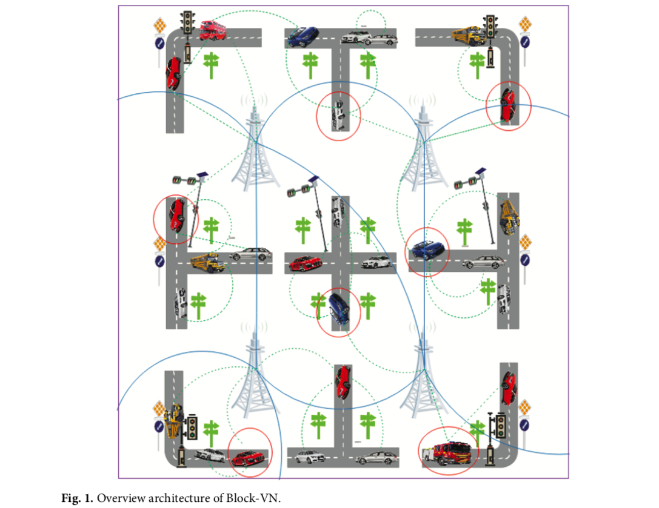

Slide 10
Block-VN Distributed Architecture (Continued)
By using the minor and controller nodes in a distributed way, we can achieve the scalability and high availability of the vehicle network.
Also improves vehicle network architecture by enabling consumer-to-machine and machine-to-machine trusted intermediary free services and by providing distributed, secure and shared records of all services, assets, and inventories.

Slide 11
Model Architecture
Each time the registration of a new vehicle issued, the department of motor vehicles (manufacturers) provides full details to the revocation authority.
The revocation authority has the power to decide which vehicle considers to be the minor node outside the nodes of the controller.
The revocation authority also provides all information of ordinary and minor vehicle nodes to the distributed blockchain vehicle network.

Slide 12
Model Architecture (Continued)
Each controller node includes - hash, a timestamp, a nonce and Merkle root to hold all the information required to provide the necessary services.
Each controller works at individual level to process and compute the data and share it to other nodes in a distributed manner.
Each communication will be made using the public-private key encryption technique to secure the privacy of the client’s data.

Slide 13
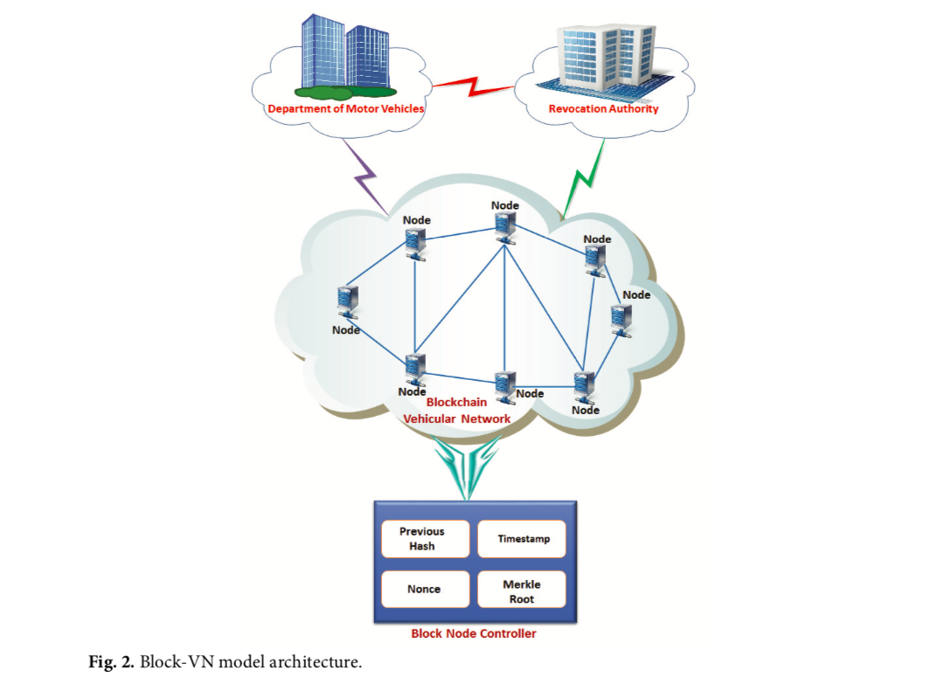

Slide 14
Miner Node’s Structural Design
Each miner node vehicle has three asset classifications: computing, sensors, and data storage
Data Storage - stores the substance of the vehicle created from applications and sensors and in addition to recording visuals and multimedia. It supports the sharing of information between members of the blockchain network.
Sensors - can auto-activate and further distinguish the opportunities in the physical world. With technological progress, each sensor is specifically associated so that the outer frames can read the sensor information as well as control the sensor.
Computing Asset - similar to that of the blockchain controller node regardless of whether its capacity is limited in view of the fact that it is an accumulation of portable assets.

Slide 15
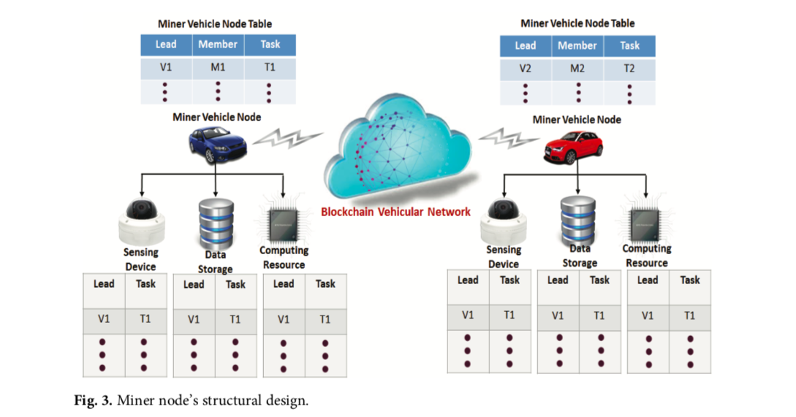

Slide 16
Service Scenario - SmartPay
Alice gets in her car to drive to work. Her car consequently synchronises with the SmartPay functionality on her mobile phone.
SmartPay starts a few elements on Alice’s in-car show; it connects to journey planner and chooses her office as the destination.
An advantageous petrol station is routed which is promoting aggressive fuel costs. In the wake of topping off with fuel, the cost is consequently paid for by SmartPay’s smart contact.
Alice’s daughter’s smart contract will allow her to borrow the car and use the SmartPay functionality to refuel but not to make unscheduled payments at fast-food joints.

Slide 17
Service Scenario - SmartShare
Real-time ride-sharing can be easily accomplished by Block-VN model.
Block-VN model of constant travel sharing allows private car owners to give their empty seats to others venturing to each part of a similar course.
It also offers a multi-rebound response for riders to switch between a few vehicles on their approach to goals, focusing on expanding the number of coordination rides and additionally making a more vigorous scope on customer needs transport.
In contrast to Lyft and Uber, Block-VN can take ride-sharing to the next level of decentralized, the group owned-and-supervise transportation arrangements without unacceptable embedded decision-making or risks such as privacy leaks and surges pricing.

Slide 18
Proposed Design Principles for VN
Distributed operations - In Block-VN, there is no cooperative specialized in the clouds, and each vehicle plays at the same time the parts of supplier and buyer. In addition, vehicle assets are constrained. That is, a buyer step must look for assets on demand and adapt to the circumstances in which the assets accessible in the blockchain network are not as much as what it requires.
Management of service content - Block-VN substance can be created by a coordinated effort between different vehicles and miner with their sensory information and assets. At the moment when their legitimacy lapses, they should be placed on the system of blockchains to save the assets of the system.

Slide 19
Proposed Design Principles for VN
Privacy and security - Privacy is vital in Block-VN because the substance each vehicle creates tends to reveal individual data. An anonymization plan can help solve the problem. Future research should also address the concerns of protecting buyers in the administration. They effectively search for assets and substance on the network.
Fault tolerance - Block-VN services depend heavily on sensory information collected from vehicles. This reduces at the time of administration various forms of basic leadership spending collection of sensors. In any case, sensors can be physically broken, glitch, or be traded for the purpose that they can transmit inaccurate information to procedures or even neglect to convey information.

Slide 20
Conclusion
Vehicular communication develops with the rise of new ideal models.
We have examined the applications of the ad hoc vehicle network and observed the remarkable features that cannot be effectively supported by the existing system.
Block-VN model allows vehicles to discover and share their resources to create a network of vehicles on which they work together to produce value-added services.

Slide 21
Future work and Current Ideas
Research into financing of mobile vehicles in a shared economy.
Seek to integrate the blockchain and wearable technology.
Explore applications of the impeccable public storage of the blockchain, coupled with a distributed file system model provided to manage scaling, transparency and security.

